Slide 1
Jim Murphy Executive Director
922 Austin Lane, #C-1
Honolulu, HI 96817
808-538-7373

Slide 2
Habitat for Humanity
How it Works
Houses are built largely with volunteer labor
In-kind donations of material and services help reduce construction cost
Homeowners invest hours of sweat equity into the construction of their home
Sold to families with no-profit margin, which means your mortgage goes into funding another build! ☺
Mortgage length ranges from 20-38 years, depending on funding source

Slide 3
Habitat for Humanity
How Families are Selected
Three Important Selection Criteria
Housing Need - Currently struggling w/ inadequate housing
Qualifying income level, financially stable and unable to get conventional home financing.
Willingness to become a partner (volunteer/sweat equity)
Non discriminatory selection policy (family’s name remain anonymous until approved)

Slide 4
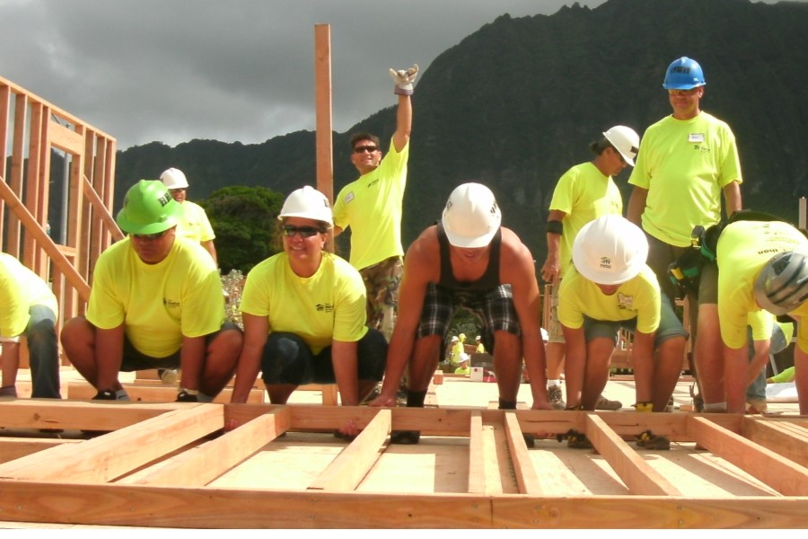
Habitat for Humanity
Homeowner “sweat equity”
All homeowners contribute “sweat equity” by working in partnership with the affiliate and other volunteers.
Pride in ownership from personal investment
Development of skills and knowledge while building
Partnership and interaction with others who are part of the movement.

Slide 5
Habitat for Humanity Honolulu County, Oahu
What does an Affiliate do?
Works with donors, volunteers and homeowners.
Build or renovate simple, decent and affordable housing.
Primary responsibility for:
Legal matters, organization.
Fundraising.
Family selection and support.
Finance.
Construction.

Slide 6
Habitat for Humanity
Statewide presence
Habitat for Humanity Maui
Kauai Habitat for Humanity
Habitat for Humanity Hawai’i Island
Molokai Habitat for Humanity
Honolulu Habitat for Humanity
Leeward Habitat for Humanity

Slide 7
Habitat for Humanity
Statewide presence
Habitat for Humanity Maui
Kauai Habitat for Humanity
Habitat for Humanity Hawai’i Island
Molokai Habitat for Humanity
Honolulu Habitat for Humanity
Leeward Habitat for Humanity
Built or renovated over 450 homes on Hawaiian Home Lands!!!

Slide 8
Our programs
Home Build
Home Preservation
Both of our programs take you through the path of homeownership.

Slide 9
Our contact info:
Rozie Breslin Family Services Coordinator rozie@honoluluhabitat.org 808-777-4138 | TJ Joseph Operations Manager tj@honoluluhabitat.org 808-538-7575
Jim Murphy Executive Director jmurphy@honoluluhabitat.org 808-538-7373 | Honolulu Habitat for Humanity 922 Austin Lane, #C-1 Honolulu, HI 96817

